Slide 1
Store management system
Subhashkumar
Nithin Menezes
Mithun Mathai

Slide 2
INTRODUCTION
The Store Management System is a web application where the admin of the store has the power to add a store, create new admin profiles for new admins, create transactions when the items are either sold or bought to the store and view available stock in the store. When store data is not properly handled it leads to various problems. Eg: A store didn’t keep track of which transaction updated with items from the stock, later on the store owner finds out that the items are faulty, the store owner will be clueless on which supplier sent the faulty items. Whenever there’s a new admin from a particular store with some license number, before creating a new admin profile for that admin, the store should be added to the database.

Slide 3
PROBLEM STATEMENT
The store management system stores information about the store, admins, transactions, and available stock in a store indicating the following:
• Details of the store(Address and license number )
• Admins of the store each having an ID, unique username and password.
• Transaction created by admin which has a unique transaction number.
• Stock has stock type, item name, price of each item, quantity and stock ID.
• When a transaction is created by the admin, it updates the stock.
• An Admin can view the stock available in the store.
• Each admin must have only one store.
• Each transaction can have only one admin

Slide 4
V-MODEL
V model is an extension of the waterfall model and is based on association of testing face for each corresponding development stage.
Its execution of processes happens in a sequential manner in V shape.
It is also known as Verification and Validation Model.
The V-shaped model is used for small to medium sized projects where requirements are clearly defined and fixed.
The V-Shaped model should be chosen when ample technical resources are available with needed technical expertise.
High confidence of customer is required for choosing the V-Shaped model approach. Since, no prototypes are produced, there is a very high risk involved in meeting customer expectations.

Slide 5
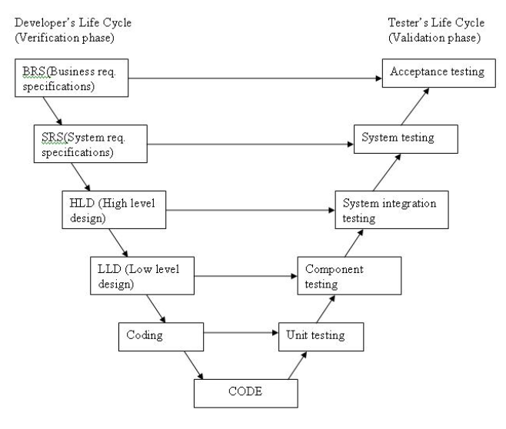
V model

Slide 6
The various phases of the V-model are as follows:
Requirements like BRS and SRS begin the life cycle model just like the waterfall model. But, in this model before development is started, a system test plan is created. The test plan focuses on meeting the functionality specified in the requirements gathering.
The high-level design (HLD) phase focuses on system architecture and design. It provide overview of solution, platform, system, product and service/process. An integration test plan is created in this phase as well in order to test the pieces of the software systems ability to work together.
The low-level design (LLD) phase is where the actual software components are designed. It defines the actual logic for each and every component of the system. Class diagram with all the methods and relation between classes comes under LLD. Component tests are created in this phase as well.
The implementation phase is, again, where all coding takes place. Once coding is complete, the path of execution continues up the right side of the V where the test plans developed earlier are now put to use.
Coding: This is at the bottom of the V-Shape model. Module design is converted into code by developers. Unit Testing is performed by the developers on the code written by them.

Slide 7
Advantages of V-model:
Simple and easy to use.
Testing activities like planning, test designing happens well before coding. This saves a lot of time. Hence higher chance of success over the waterfall model.
Proactive defect tracking – that is defects are found at early stage.
Avoids the downward flow of the defects.
Works well for small projects where requirements are easily understood.
Disadvantages of V-model:
Very rigid and least flexible.
Software is developed during the implementation phase, so no early prototypes of the software are produced.
If any changes happen in midway, then the test documents along with requirement documents has to be updated.

Slide 8
Use case diagram

Slide 9
